Slide 1

G2M Insight for Cab Investment
Firm
Virtual Internship
Submitted by: Mark Maina

Slide 2
Problem Statement
XYZ is a private equity firm in US. Due to remarkable growth in the Cab Industry in last few years and multiple key players in the market, it is planning for an investment in Cab industry.
Objective : Provide actionable insights to help XYZ firm in identifying the right company for making investment.
The analysis has been divided into four parts:
Data Understanding
Forecasting profit and number of rides for each cab type
Finding the most profitable Cab company
Recommendations for investment

Slide 3
Data Information
Cab_Data.csv – This file contains information about individual trips for both cab companies.
City.csv – This file contains information about the cities where the cab companies operate along with their populations vs the number of users.
Customer_ID.csv – This file contains information about each customer’s details.
Transaction_ID.csv – This file contains information about each transaction’s payment details.

Slide 4
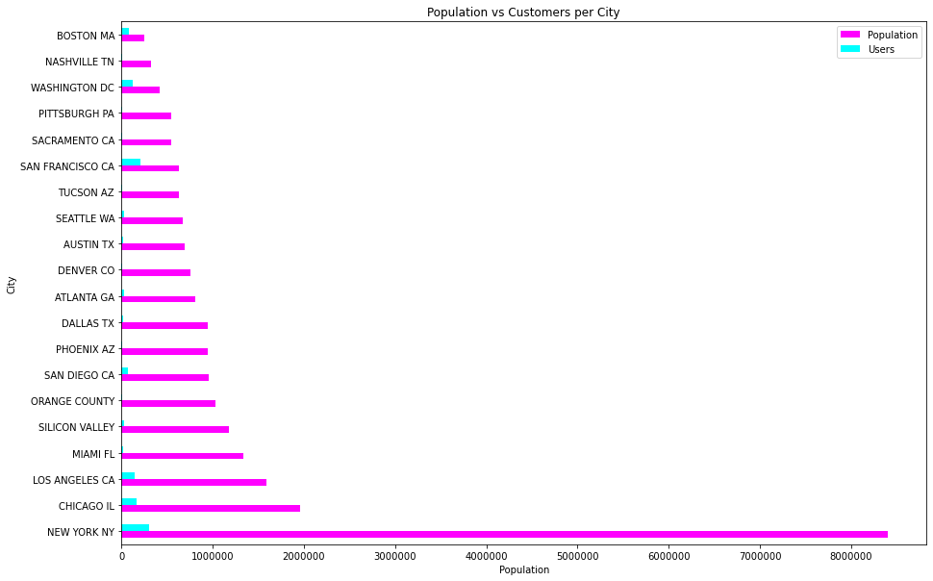
Exploratory
Data
Analysis
Customers
Number of user per city vs the total population of the city

Slide 5
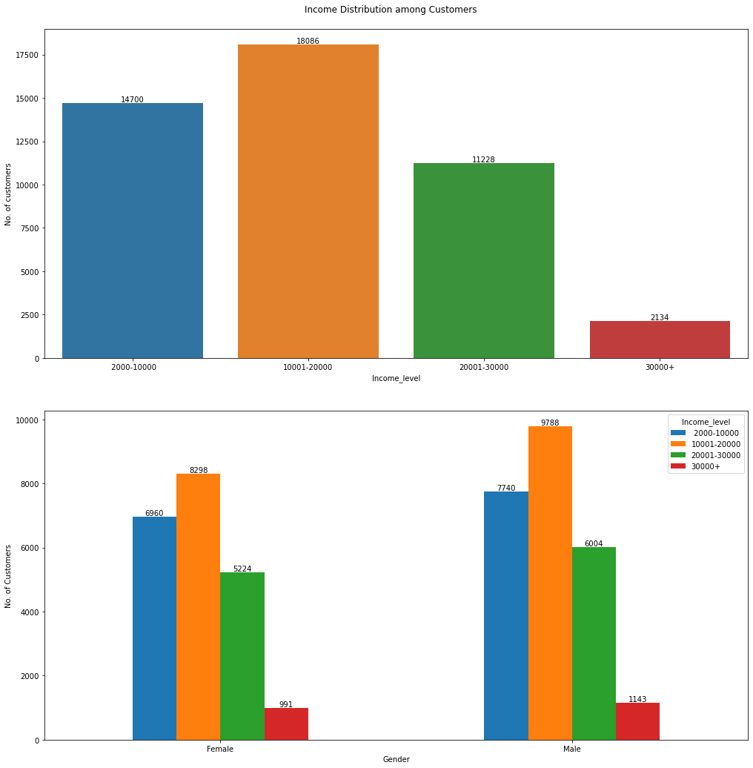
Exploratory
Data
Analysis
Customers
Number of customer per income band
Number of customers in each band with respect to gender

Slide 6
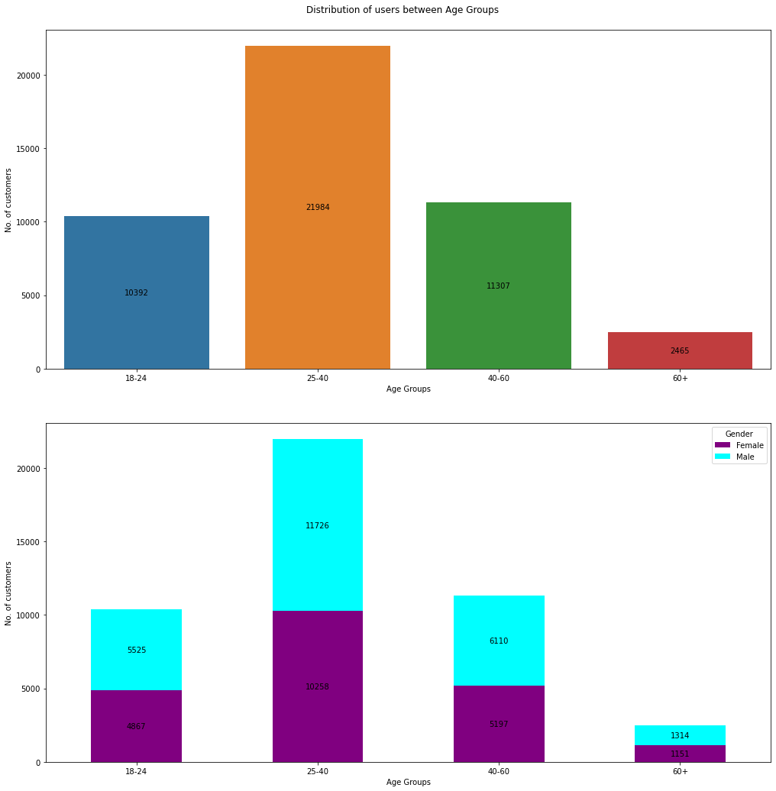
Exploratory
Data
Analysis
Customers
Number of customer per age bracket.
Number of customers in each bracket with respect to gender

Slide 7
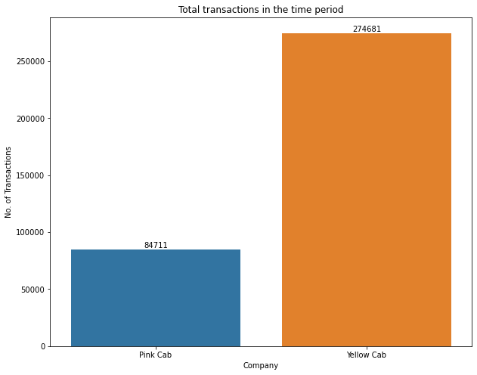
Exploratory
Data
Analysis
Transactions
Total number of transactions per company.

Slide 8
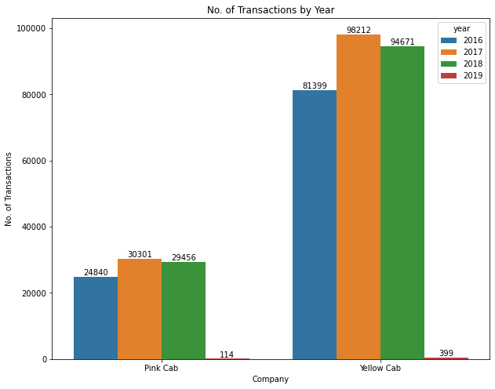
Exploratory
Data
Analysis
Transactions
Total number of transactions for each year per company.

Slide 9
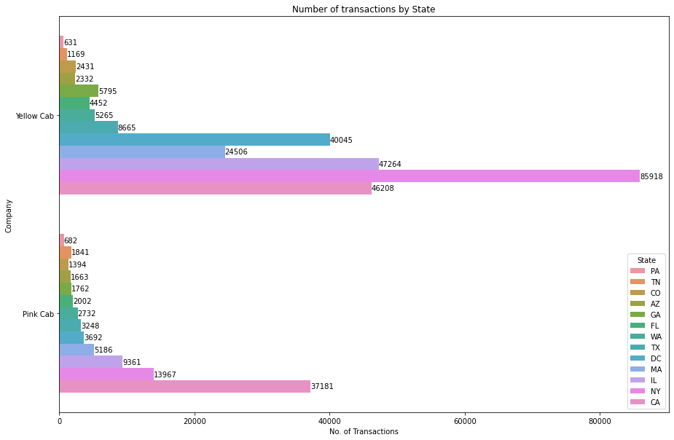
Exploratory
Data
Analysis
Transactions
Total number of transactions for each company per State.

Slide 10
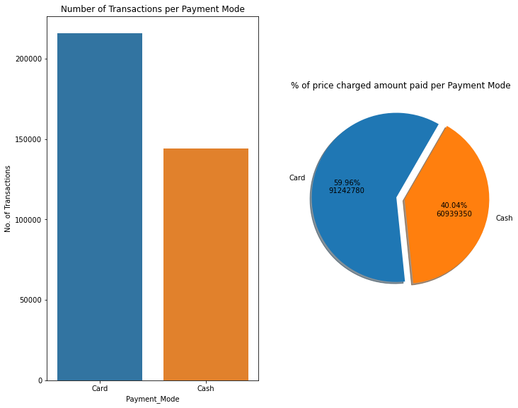
Exploratory
Data
Analysis
Transactions
Total number of transactions for each payment mode.
Total amount paid per payment mode

Slide 11
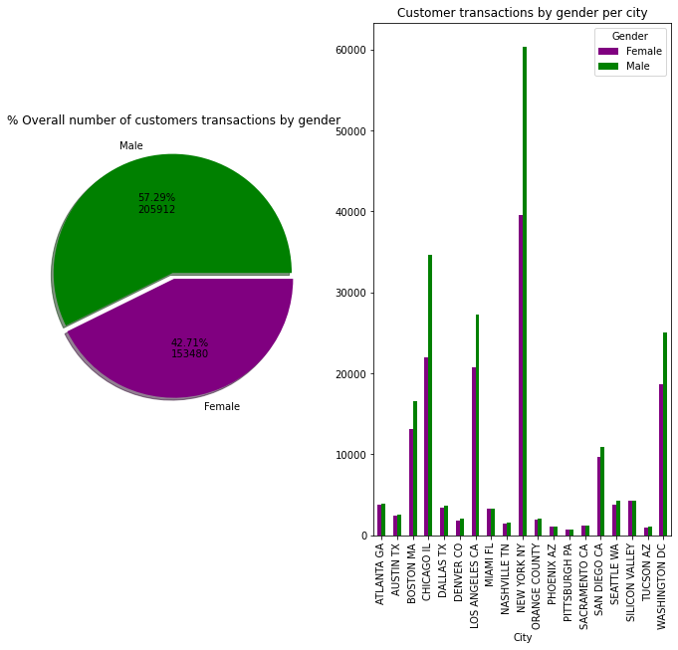
Exploratory
Data
Analysis
Transactions
Total number of transactions for by customer gender.
Total number of customer transactions by gender per city.

Slide 12
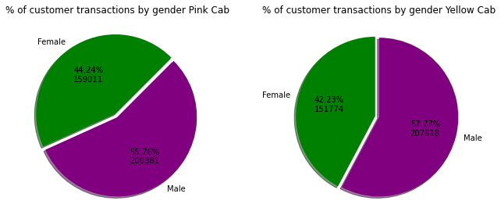
Exploratory
Data
Analysis
Transactions
Total number of customer transactions by gender per cab company.

Slide 13
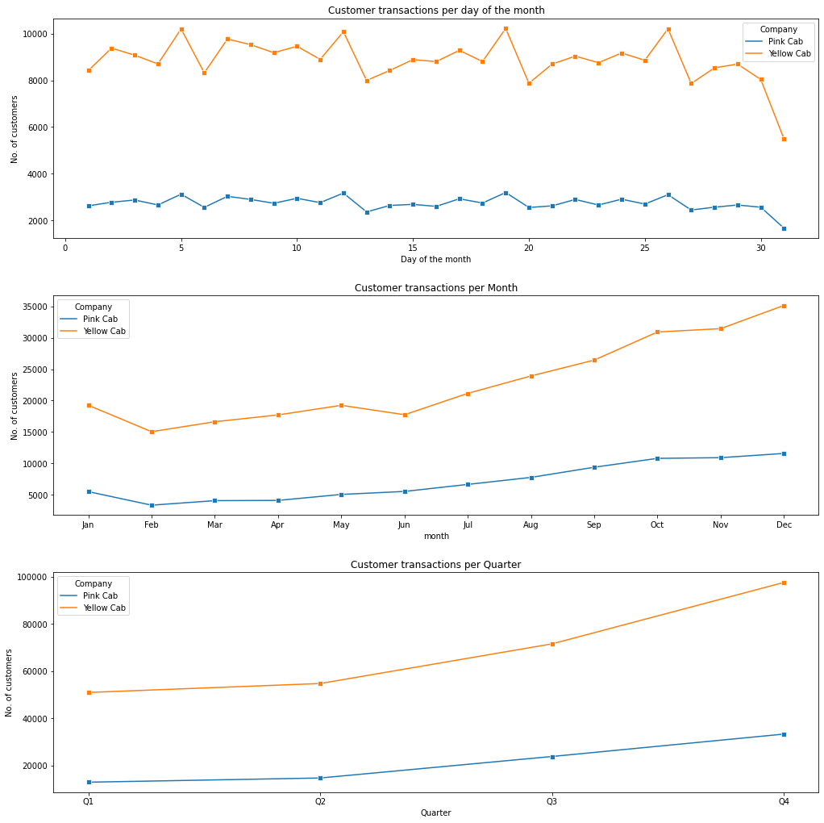
Exploratory
Data
Analysis
Seasonality
Total number of customer transactions per day of the month.

Slide 14
Exploratory
Data
Analysis
Seasonality
Total number of customer transactions per month for all the years captured.
Total number of customer transactions per quarter for all the years captured.

Slide 15
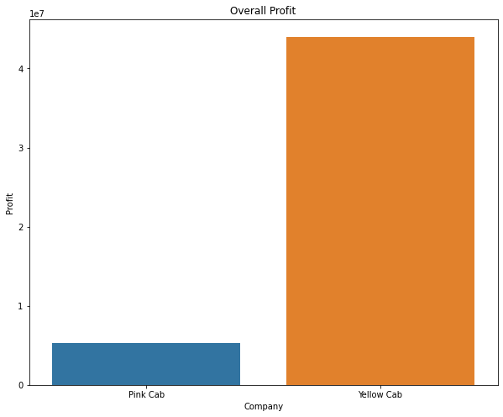
Exploratory
Data
Analysis
Profits
Overall profits per company

Slide 16
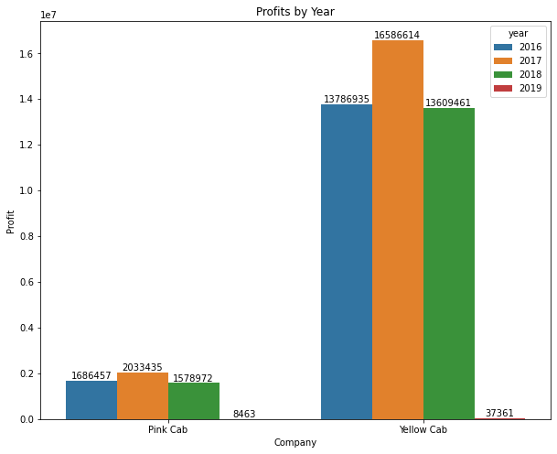
Exploratory
Data
Analysis
Profits
Profits for each company per year.

Slide 17
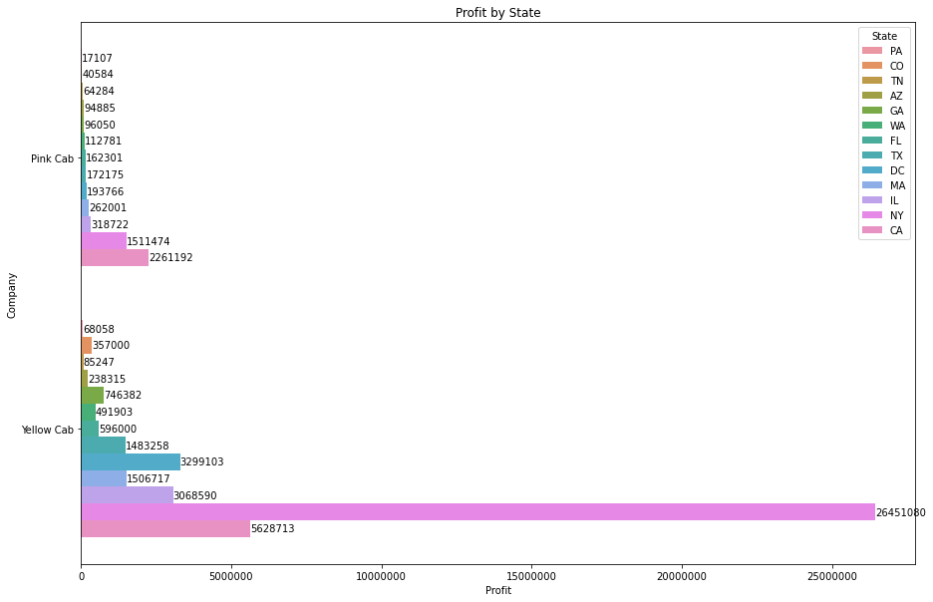
Exploratory
Data
Analysis
Profits
Profits for each company per state.

Slide 18
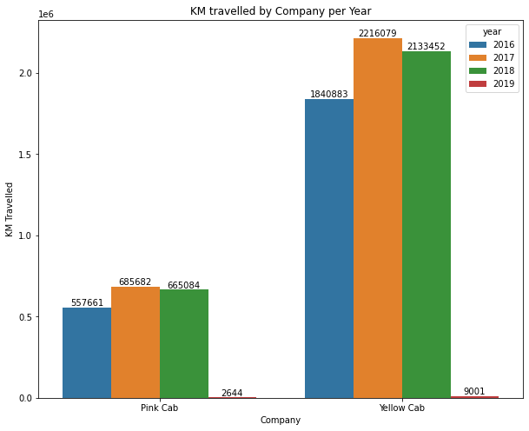
Exploratory
Data
Analysis
Profits
Total KMs travelled by each company per year

Slide 19
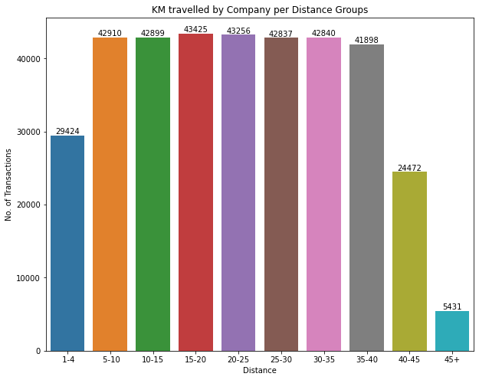
Exploratory
Data
Analysis
Profits
Distance distribution vs number of transactions

Slide 20
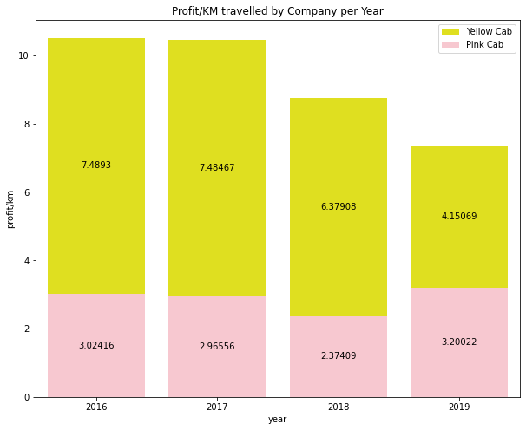
Exploratory
Data
Analysis
Profits
Profit per KM for each company per year.

Slide 21
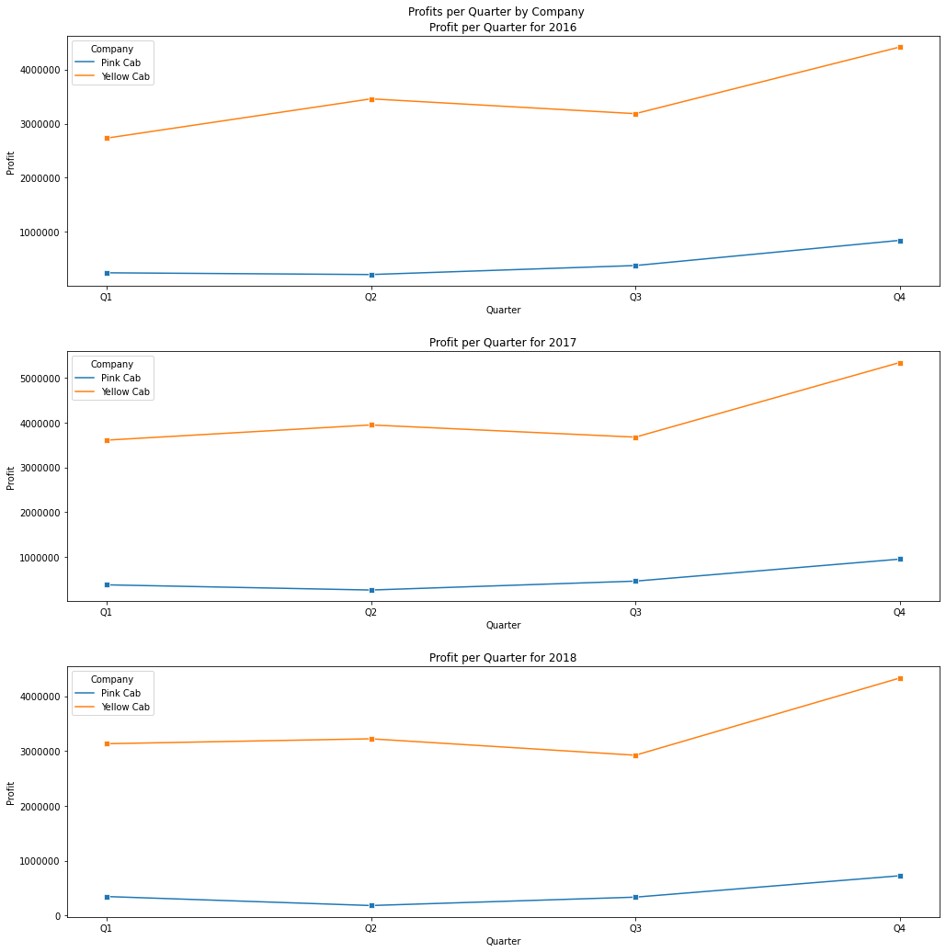
Exploratory
Data
Analysis
Profits
Profit per quarter for each company per year.

Slide 22
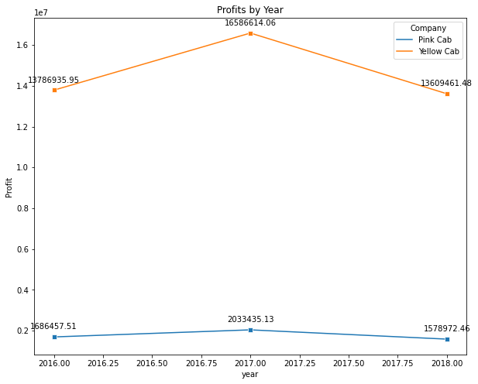
Exploratory
Data
Analysis
Profits
Profits for each company per year.

Slide 23
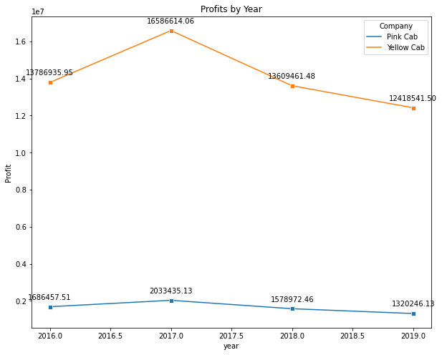
Exploratory
Data
Analysis
Profits
Profit prediction for each company for the year 2019.

Slide 24
Hypothesis
Testing
Hypothesis 1
H0 = There is no difference between average profits from male customers transactions and female customer transactions
H1 = There is a difference between average profits from male customers transactions and female customer transactions
Hypothesis 2
H0 = There is no difference between average profits made from card payments and cash payments
H1 = There is a difference between average profits made from card payments and cash payments

Slide 25
Hypothesis
Testing
Hypothesis 3
H0 = There is no difference between average profits for each company
H1 = There is a difference between average profits for each company
Hypothesis 4
H0 = There is no difference between average profits for 2016, 2017 and 2018 for Pink company
H1 = There is a difference between average profits for 2016, 2017 and 2018 for Pink company
Hypothesis 5
H0 = There is no difference between average profits for 2016, 2017 and 2018 for Yellow company
H1 = There is a difference between average profits for 2016, 2017 and 2018 for Yellow company

Slide 26
Recommendations
From the EDA exercise it was observed that:
Customer wise: Yellow cab company has more customers than Pink cab company
Transaction wise: Yellow cab company has conducted significantly more transactions than Pink cab company
Seasonality wise: Both companies transactions tend to start low and end higher towards the end of the year
Profit wise:
Yellow company’s profits are significantly higher than Pink company’s.
Yellow company’s profit per KM are also atleast double those of Pink company’s
Yellow company’s profit for 2019 is projected to be higher than Pink company’s
It is recommended that Yellow Cab Company be chosen for investment based on the above observations

Slide 27

Thank You

